Slide 1
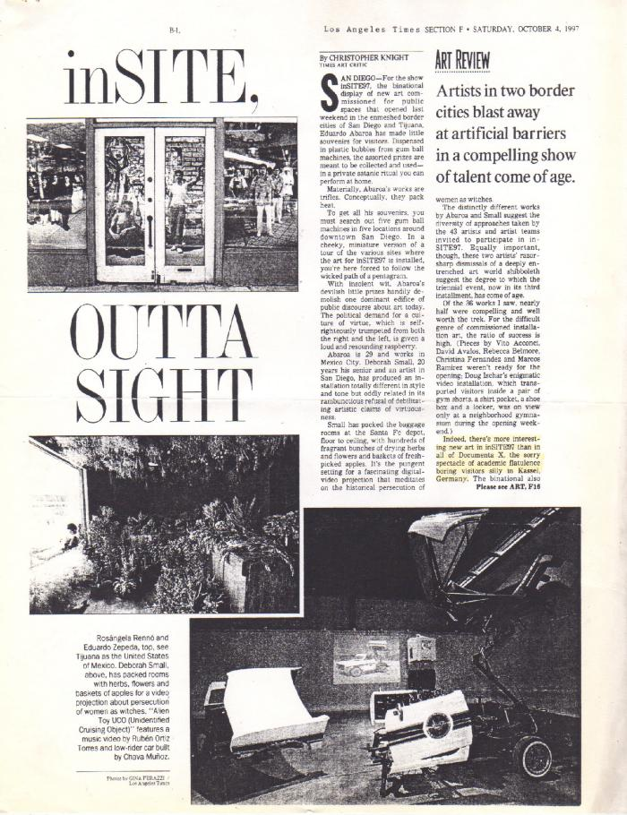
InSITE outta sight (GD-D-00562)

