Slide 1
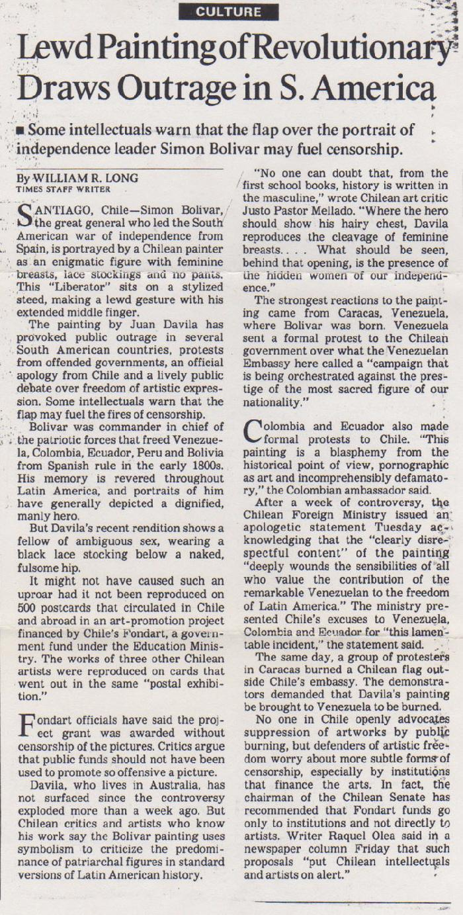
Lewd paintings of revolutionary draws Outrage in South America (GD-D-00498)

