Slide 1
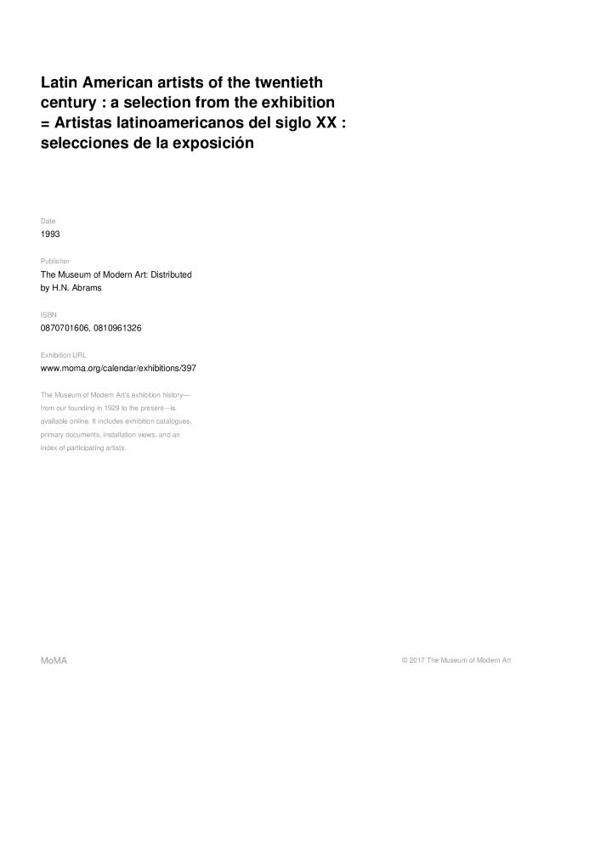
Latin American Artist of the Twentieth Century. A selection from the exhibition (GD-D-00120)

