Slide 1
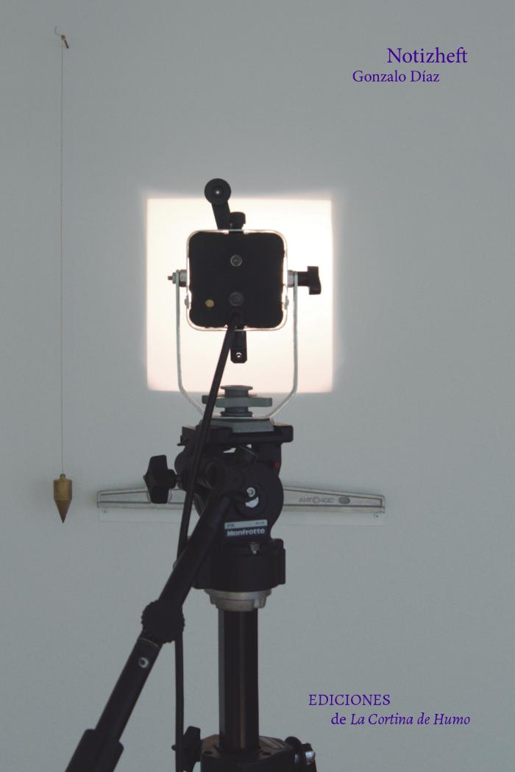
Notizsheft (GD-D-00315)

