Slide 1
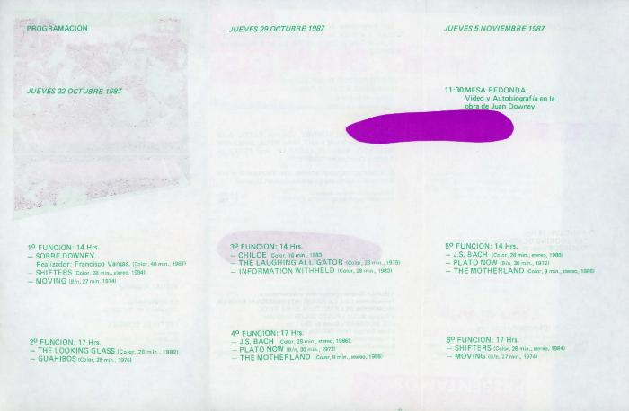
Festival Downey (GD-D-00069)

Slide 2
Festival Downey (GD-D-00068)

